Slide 1
Different types of keys in SQL - 01
Super Key: It is a combination of all possible attributes that can uniquely identify a row/record within a table. It can include more details than necessary for a primary key. Super key is a superset to candidate key.
Eg. {Roll_no., Name, email_id, Gender, aadhar_no.}
Candidate Key: A candidate key is a minimal super key or a super keu with no redundant attributes. Candidate Keys are potential options for Primary Keys. They share the properties of uniqueness and minimal redundancy.
Eg. 1. Roll no 2. email_id 3. aadhar_number
Roll No | Name | Email_id | Aadhar_No.
1 | Archana | archana@gmail.com | 11223edf
2 | Krithik | krithik@gmail.com | 223535345h
3 | Skanda | skanda@gmail.com | fgdfgdfg55
4 | Krish | krish@gmail.com | gretyre64454

Slide 2
Different types of keys in SQL - 02
Primary Key: A primary key is one of the candidate key chosen by the DBA to uniquely identify each record within a table. One of the candidate keys is selected as the most important and becomes the primary key. There cannot be more than one primary key in a table. Primary key ensures data uniqueness and serves as a reference for establishing relationships between tables. It is unique and does not contain Null values
Eg. Roll no
Alternate Key: Out of all the candidate keys one key is selected as primary key and the remaining are alternate keys. An Alternate Key is a candidate key that isn't chosen as the Primary Key. It provides additional options for uniquely identifying records.
Eg: 1. email_id, 2. aadhar_number
Roll No | Name | Email_id | Aadhar_No.
1 | Archana | archana@gmail.com | 11223edf
2 | Krithik | krithik@gmail.com | 223535345h
3 | Skanda | skanda@gmail.com | fgdfgdfg55
4 | Krish | krish@gmail.com | gretyre64454

Slide 3
Different types of keys in SQL - 03
Composite Key: A Composite Key uses multiple columns to create a unique identifier. It's useful when a single column cannot ensure uniqueness.
Eg: roll no and subject
Unique Key: Like a Primary Key, a Unique Key enforces uniqueness but allows null values. It's used for columns that must be unique but might contain missing information. The unique key is similar to the primary key in a table, but it can accept NULL values, whereas the primary key does not.
It accepts only one NULL value.
It cannot have duplicate values.
It can also be used as a foreign key in another table.
A table can have more than one Unique column.

Slide 4
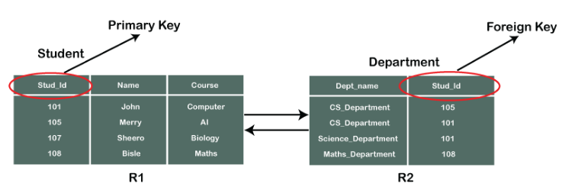
Different types of keys in SQL - 03
Foreign Key: A Foreign key establishes a link between two tables. A foreign key is a field in one table that refers to the primary key in another table

